Slide 1
Come in Quietly
Take out a pen or pencil

Slide 2
Objective: Evaluate the major debates over slavery that occurred when writing the Constitution.
Objective
Standard 8.2.3: Evaluate the major debates that occurred during the development of the Constitution and their ultimate resolutions in such areas as shared power among institutions, divided state-federal power, slavery, the rights of individuals and states (later addressed by the addition of the Bill of Rights), and the status of American Indian nations under the commerce clause.
RH 8.7: Integrate visual information (e.g., in charts, graphs, photos, videos, or maps) with other information in print and digital texts.

Slide 3
Prior Knowledge:
You already know about the Great Compromise.
What problem did the Great Compromise solve?

Slide 4
Steps:
Read the text.
List the key facts about each plan on the Graphic Organizer.
Highlight similarities between the plans.
Skills
Northern Position | 3/5ths Compromise | Southern Position
 | Roger Sherman

Slide 5
Slavery
The Atlantic Slave Trade
Skills

Slide 6
Slavery and Population
22. When the delegates met for the Constitutional Convention, the Slave Trade was a major issue. 23. Delegates from Southern states wanted to make sure the new Constitution did not abolish slavery itself or interfere in the Slave Trade. 24. Delegates from Northern states knew that they would not be able to get slavery abolished but they did want some limits on the Slave Trade. 25. Their compromise was to agree to not make any laws pertaining to slavery or the slave trade for the next twenty years. 26. After that, the issue could be revisited.
27. Another major issue relating to slavery that the writers of the Constitution faced was population. 28. Throughout the discussions of the Constitutional Convention, the issue of a government based on the population of the states was brought up. 29. Northern states, who were mostly free of slaves, believed that since a slave could not vote, they should not count as part of the population. 30. Southern states, however, believed that since slaves were a part of their daily lives and economic welfare, they should be counted as part of the population. 31. Roger Sherman, a delegate from Connecticut, proposed a compromise that was eventually agreed upon by both the Northern and Southern states. 32. Each slave would count as 3/5 of a person when population was counted to determine the number of representatives each state would receive in the government.
Skill - We Do/Independent
Notes:
I Do, was yesterday or you can do the Southern States as the I DO. Otherwise, First Paragraph is We Do, Second Paragraph is Independent Practice

Slide 7
Steps:
Read the text.
List the key facts about each plan on the Graphic Organizer.
Highlight similarities between the plans.
Skills
Northern Position | 3/5ths Compromise | Southern Position
 | Roger Sherman
did want some limits on the Slave Trade
not make any laws pertaining to slavery or the slave trade for the next twenty years
Constitution did not abolish slavery itself or interfere in the Slave Trade

Slide 8
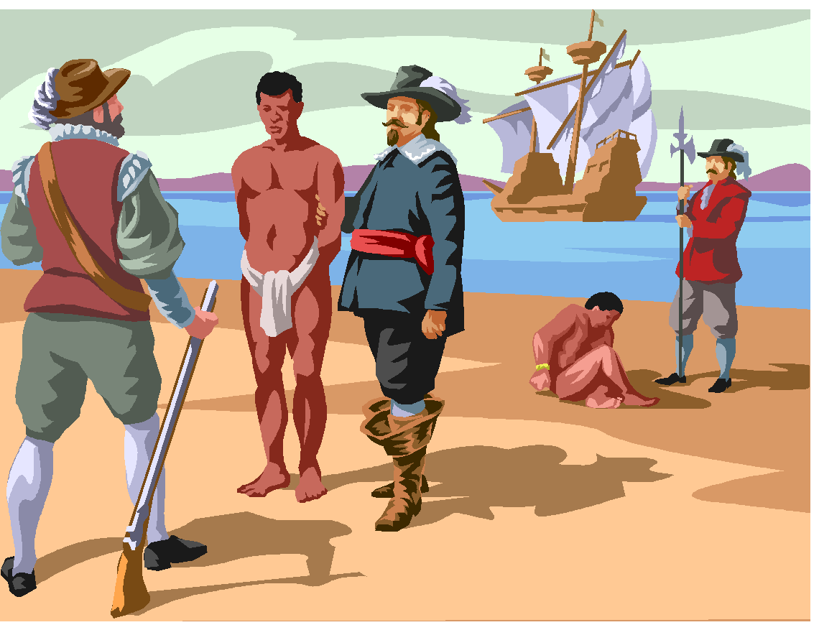
The Slave Trade Compromise
The North worried that the South could control Congress simply by importing more slaves
A limit on the importation of Slaves was agreed upon
Slaves could be imported only until 1808
Each imported slave would have a $10.00 tax levied upon the transaction
In exchange for the delay in ending the import of slaves the South agreed to let the national government regulate slave trade.
Notes:
8

Slide 9

The 3/5 Compromise
I count!
Southerners wanted to count slaves towards representation in Congress but not taxes.
Northerners realized that this would allow the south to dominate (control) Congress
I don’t, oh no!
Northerners argued that slaves were not free and therefore could not be counted toward representation but should count for taxes.
A compromise was reached: three out of every five slaves would be counted for the purpose of representation and taxes.

Slide 10
Closure
What was the disagreement between the North and South over slaves?
How was the disagreement over slavery solved?

